Slide 1

CAP539 ALGORITHM DESIGN AND ANALYSIS - Laboratory
Quick Sort – Divide and Conquer

Slide 2
Quick Sort
QuickSort is a Divide and Conquer algorithm. It picks an element as a pivot and partitions the given array around the picked pivot. There are many different versions of quickSort that pick pivot in different ways.
Always pick the first element as a pivot.
Always pick the last element as a pivot (implemented below)
Pick a random element as a pivot.
Pick median as the pivot.
The key process in quickSort is a partition(). The target of partitions is, given an array and an element x of an array as the pivot, put x at its correct position in a sorted array and put all smaller elements (smaller than x) before x, and put all greater elements (greater than x) after x. All this should be done in linear time.

Slide 3
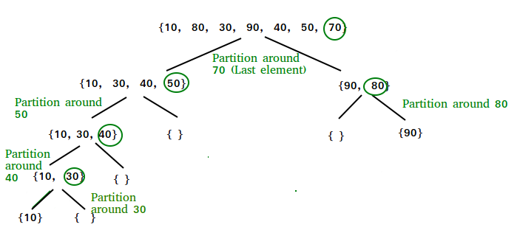
Quick Sort

Slide 4
Quick Sort
Quick Sort Recursive Algorithm:
quickSort(arr[], low, high) {
if (low < high)
{
// pi is partitioning index,
// arr[pi] is now at right place
pi = partition(arr, low, high);
quickSort(arr, low, pi – 1); // Before pi
quickSort(arr, pi + 1, high); // After pi
}
}

Slide 5
Quick Sort
Partition Algorithm:
/* This function takes last element as pivot, places the pivot element at its correct position in sorted array, and places all smaller (smaller than pivot) to left of pivot and all greater elements to right of pivot */
partition (arr[], low, high) { // pivot (Element to be placed at right position) pivot = arr[high];
i = (low – 1) // Index of smaller element and indicates the // right position of pivot found so far
for (j = low; j <= high- 1; j++){
// If current element is smaller than the pivot if (arr[j] < pivot){ i++; // increment index of smaller element swap arr[i] and arr[j] } } swap arr[i + 1] and arr[high]) return (i + 1) }

Slide 6
Quick Sort
Quick Sort Coding :
Function to swap two elements
void swap(int* a, int* b)
{
int t = *a;
*a = *b;
*b = t;
}
Function to partition the array
int partition(int arr[], int low, int high)
{
int pivot = arr[high]; // pivot
int I = (low - 1); // Index of smaller element
for (int j = low; j <= high - 1; j++) {
// If current element is smaller than the pivot
if (arr[j] < pivot) {
i++; // increment index of smaller element
swap(&arr[i], &arr[j]);
}
}
swap(&arr[i + 1], &arr[high]);
return (i + 1);
}

Slide 7
Quick Sort
Quick Sort Coding :
Quick Sort Recursive function
void quickSort(int arr[], int low, int high)
{
if (low < high) {
int pi = partition(arr, low, high);
// Separately sort elements before
// partition and after partition
quickSort(arr, low, pi - 1);
quickSort(arr, pi + 1, high);
}
}
Function to print the array
void printArray(int arr[], int size)
{
int i;
for (i = 0; i < size; i++)
cout << arr[i] << " ";
cout << endl;
}
Main function to test an array
int main()
{
int arr[] = { 10, 7, 8, 9, 1, 5 };
int n = sizeof(arr) / sizeof(arr[0]);
quickSort(arr, 0, n - 1);
cout << "Sorted array: \n";
printArray(arr, n);
return 0;
}

Slide 8
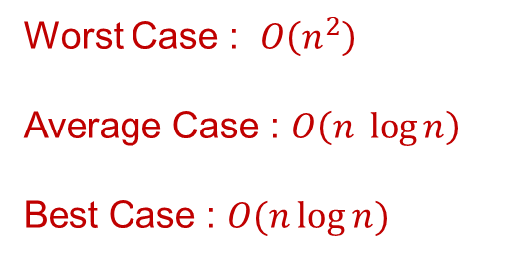
Quick Sort
Quick Sort Analysis of Time Complexity:
Worst Case : $O\left(n^{2}\right)$
Average Case : $O\left(n \log{n}\right)$
Best Case : $O(n\log{n})$
Is QuickSort stable?
The default implementation is not stable. However, any sorting algorithm can be made stable by considering indexes as comparison parameter.
Is QuickSort In-place?
As per the broad definition of in-place algorithm it qualifies as an in-place sorting algorithm as it uses extra space only for storing recursive function calls but not for manipulating the input.

Slide 9

Thank You

